Slide 1
Ionizer 2.0 User Guide
Image preprocessing and analysis
for pH and Chloride imaging
By GAB
August 2023
gabriele.nardi1@gmail.com

Slide 2
Intro
This suite includes 3 apps for image preprocessing:
FlatFieldAnalyzer: Obtain and analyze images obtained from a sample of Rhodamine 6G, for flat field correction and for monitoring the relative gain of the PMTs.
macro_process_wavelengths: This app performs some crucial steps on acquired images (collects images of the same field acquired at different excitation wavelengths; corrects for flat field; filters, registers and computes the maximum projection of z-stacks; set saturating pixels to NaN).
eROIClo: This app is a tool for visualizing processed images and for drawing ROIs in a semi-automatic fashion. It uses a general-purpose app called ROImanager to manage and measure ROIs. The output is the mean chloride value for each ROI, at all the excitation wavelengths, for both channels, and it is copied as a string into the system clipboard. It can be conveniently pasted into Microsoft Excel sheets.
Finally, it includes an app for measuring pH and Chloride from fluorescence values, i.e. ionNew_giugno2023_NewPhFunction.

Slide 3
Preliminary operations
All the apps share some functions that must be available in the Matlab path. So, it is necessary to run the function “setup_Ionizer2_environment.m” (you can find it in the main folder) before running any other app or function.
Also, the following toolboxes are needed:
-Image Processing Toolbox
-Signal Processing Toolbox

Slide 4
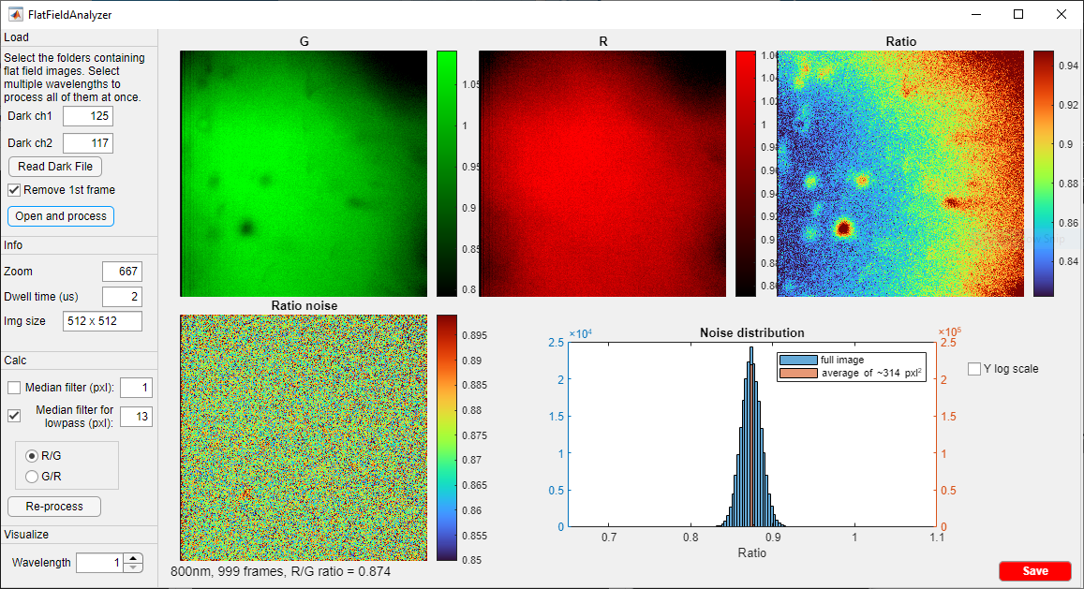
FlatFieldAnalyzer

Slide 5
FlatFieldAnalyzer
1) Insert dark values manually or use the button Read Dark File to select a dark recording and extract dark values.

Slide 6
FlatFieldAnalyzer
2) Press “Open and process” to load files and compute flat fields at each wavelength. Select all the available excitation wavelengths. Flats datasets are heavy: the loading process may take several minutes. After it’s done, you will see the images plot in the app axes as in this example.

Slide 7
FlatFieldAnalyzer
3) These are read-only info. Check that everything is correct.

Slide 8
FlatFieldAnalyzer
4) You can choose whether to visualize red / green or green / red ratio.
5) Navigate through wavelengths

Slide 9
FlatFieldAnalyzer
This option applies a median filter to G and R. Therefore, also “Ratio” will appear filtered, since it is computed as either G/R or R/G.
This option affects the output.

Slide 10
FlatFieldAnalyzer
This option perform a high-pass filtering or “Ratio” by computing a median-filtered ratio and subtracting it from “Ratio” itself to obtain “Ratio noise”. This can help to see how much noise you introduce in the g/r ratio of your acquisition by correcting for the flat field. A distribution of the “ratio noise” is also shown. It might seem you’re injecting a lot of noise, but performing a ROI-based analysis (with ROIs of area ~314 pixels²) dramatically reduces the noise level.
Since “Ratio” and “Ratio noise” are not saved, this option DOES NOT affect the output.

Slide 11
FlatFieldAnalyzer
6) Finally, save. The output will consist of:
A .tif image for each loaded wavelength. Each image contains G and R (projections normalized over the mean) at that wavelength.
A .txt file with R6G ratio at each wavelength.

Slide 12
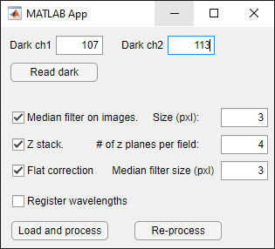
macro_preprocess_wavelengths

Slide 13
macro_preprocess_wavelengths
1) Insert dark values manually or use the button Read Dark File to select a dark recording and extract dark values.
2) Select options:
-Median filter. Recommended in case of multiple z planes: it will reduce the bias toward high values introduced by the maximum projection.
-Z-stack. Check if you recorded multiple depths for each field. Specify the number of depths.
-Register wavelengths. The images of a field acquired at different wavelengths will be aligned to make it easier the process of ROI drawing later.
3) Load files and save processed images, one image per channel. Note that this app supports multiple fields acquired at each wavelength (using multiple “Cycles” in PrarieView). In case of multiple fields, they are saved as “field 1”, “field 2”…

Slide 14
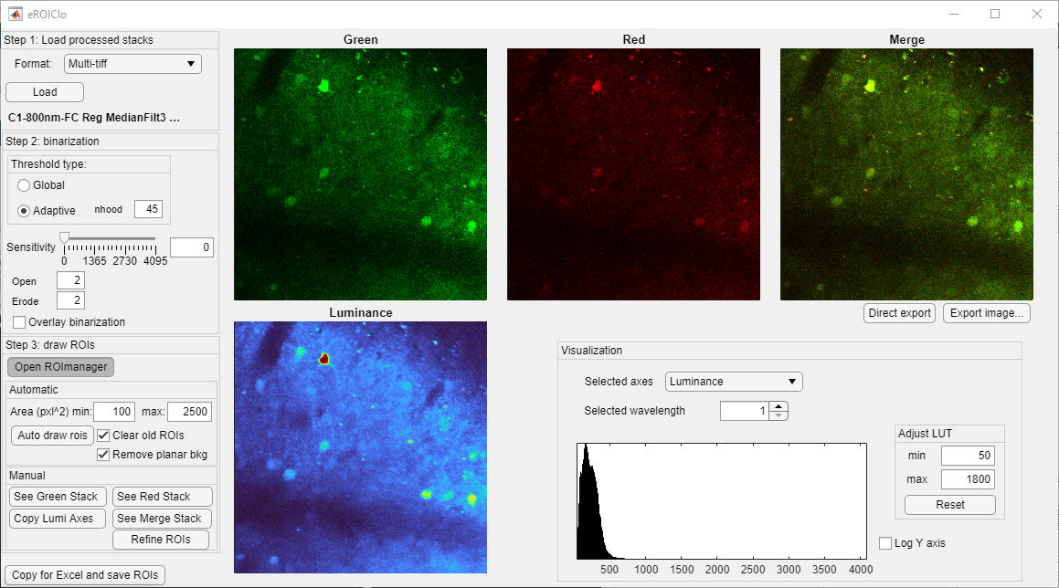
eROIClo

Slide 15
eROIClo
1) Load Ch1 of a preprocessed field. Ch2 will be automatically detected.

Slide 16
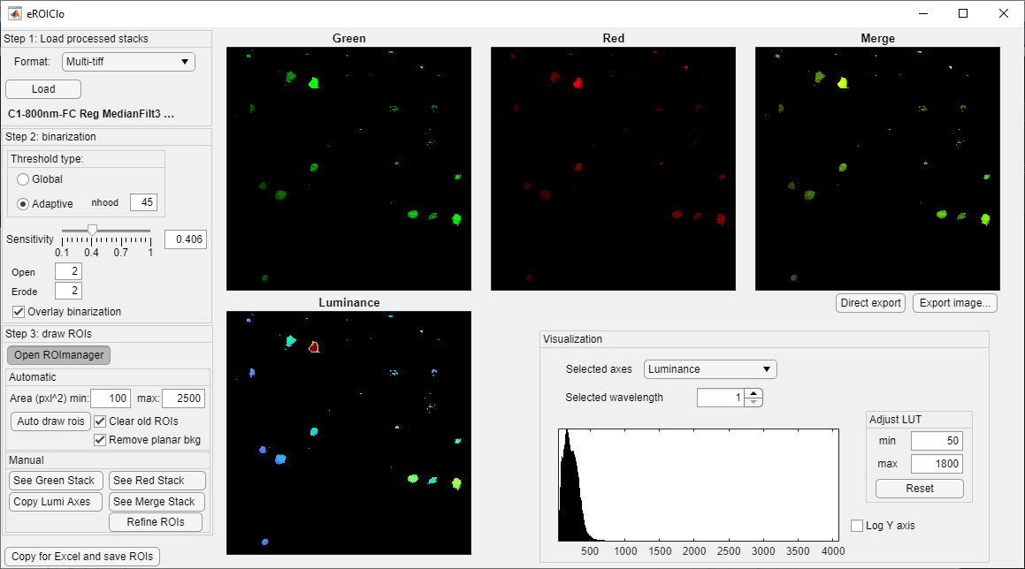
eROIClo
2) Make a binary mask. I suggest to use an adaptive (local) threshold with a neighborhood between the average cell size and twice its size. Adjust sensitivity and adjust the size of the structuring elements for opening and erosion. Check “Overlay binarization” to visualize the mask on top of the images.

Slide 17
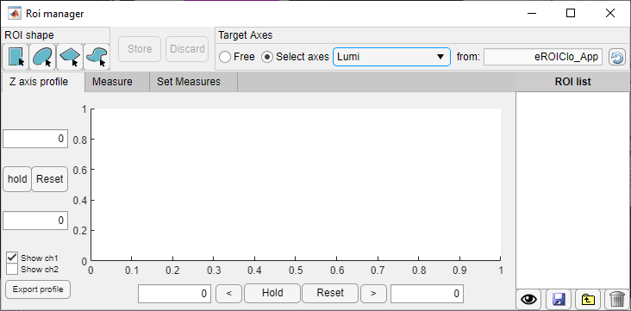
eROIClo
3) Open ROImanager.

Slide 18
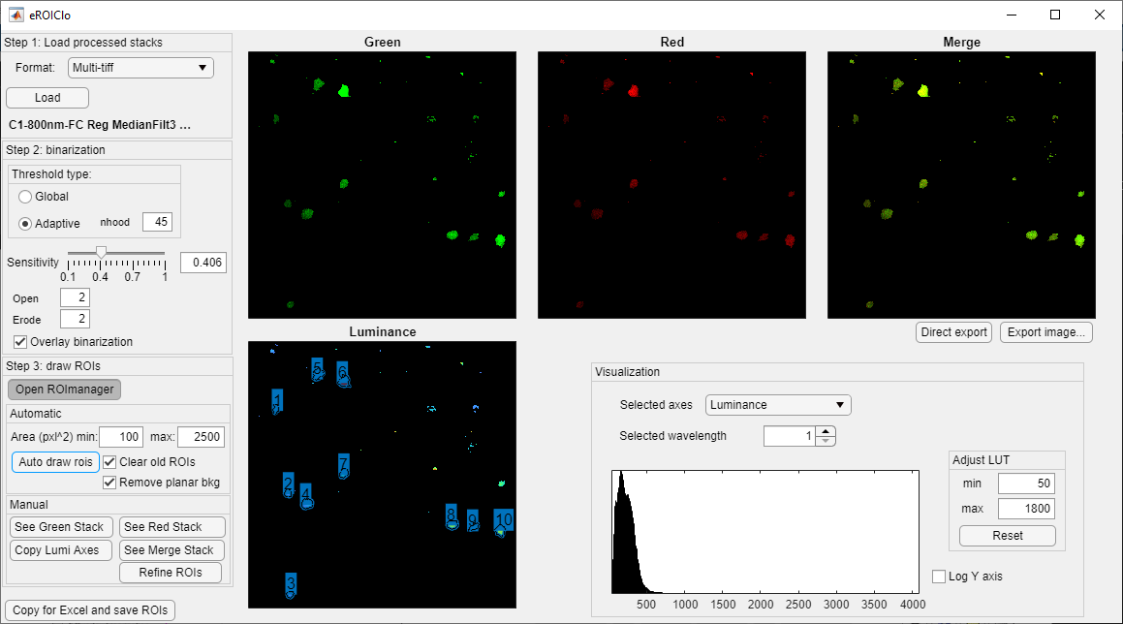
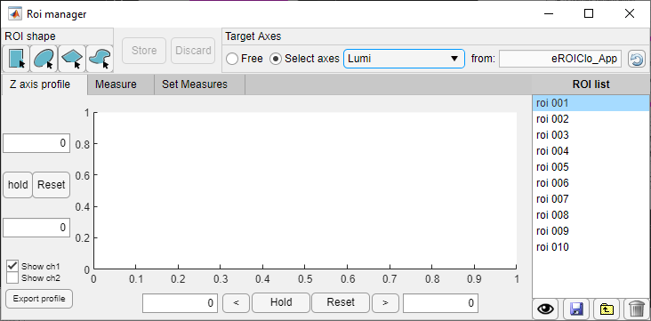
eROIClo
5) Adjust max and min ROI areas and ask the app to draw the ROIs for you. If you choose “Remove planar background”, the following operations are done:
All the false pixels in the binary mask are considered as background
A plane is fitted to those pixels, and it is subtracted to the whole image.

Slide 19
eROIClo
5) Adjust max and min ROI areas and ask the app to draw the ROIs for you. If you choose “Remove planar background”, the following operations are done:
All the false pixels in the binary mask are considered as background
A plane is fitted to those pixels, and it is subtracted to the whole image.
Move ROIs to a different axes of eROIClo
Select one or more ROIs to visualize them
Delete selected ROIs
Toggle ON to visualize all the ROIs

Slide 20
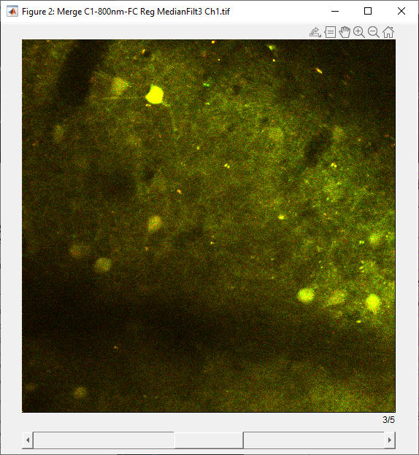
eROIClo
Use these buttons to open wavelength-stacks of one of the four “channels” in an external “ImageJ-like” window.

Slide 21
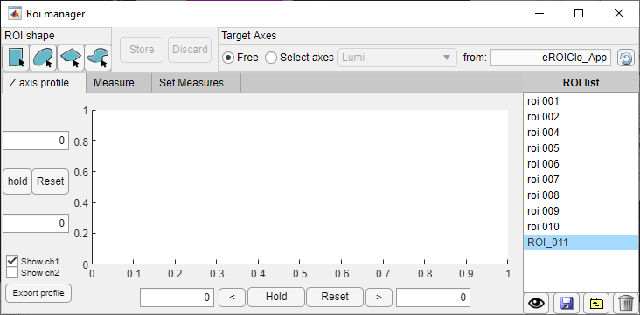
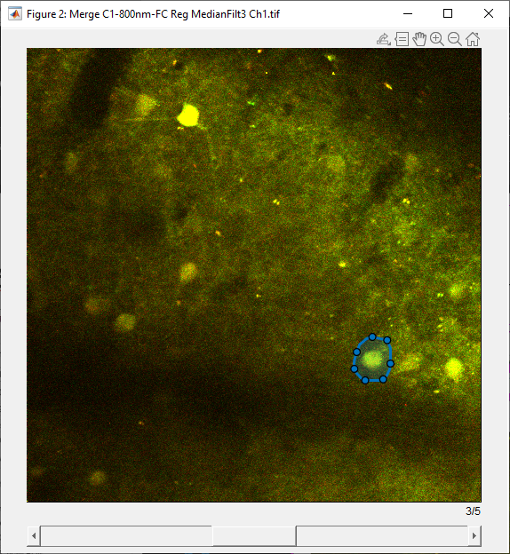
eROIClo
To draw ROIs on a separate window:
Select the round button “Free”
Click on the kind of ROI you want to draw (e.g. “freehand”)
Click once on the target axes, then draw the ROI.
Click on Discard to abort, or Store to keep the ROI. Repeat 2-4 for more ROIs.
2
1
4
3

Slide 22
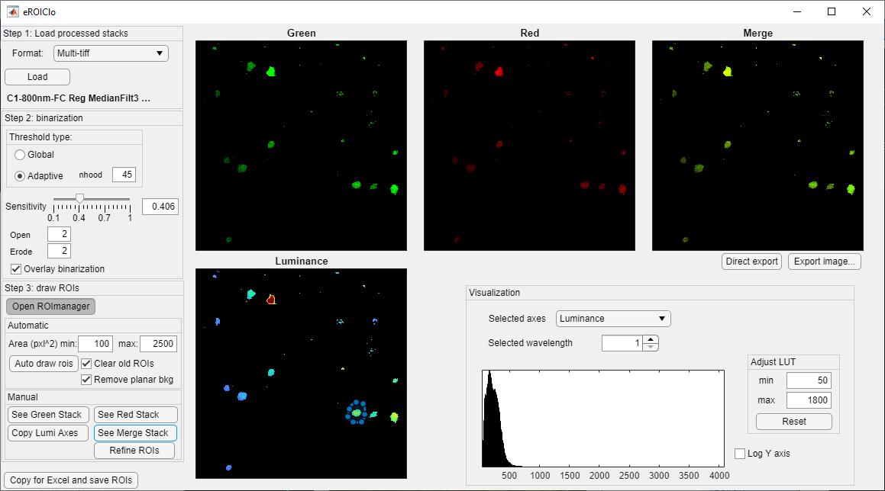
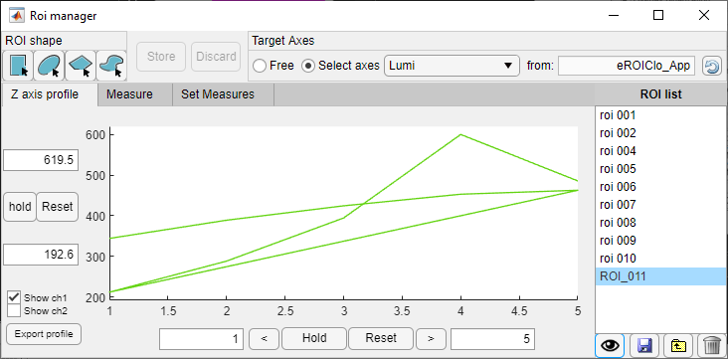
eROIClo
Alternatively, you can draw ROIs directly on the app axes. However, external axes are far better for zooming in and out and draw ROIs compared to the app’s UIAxes. With the external axes, you can also check that ROIs don’t displace too much between wavelengths.

Slide 23
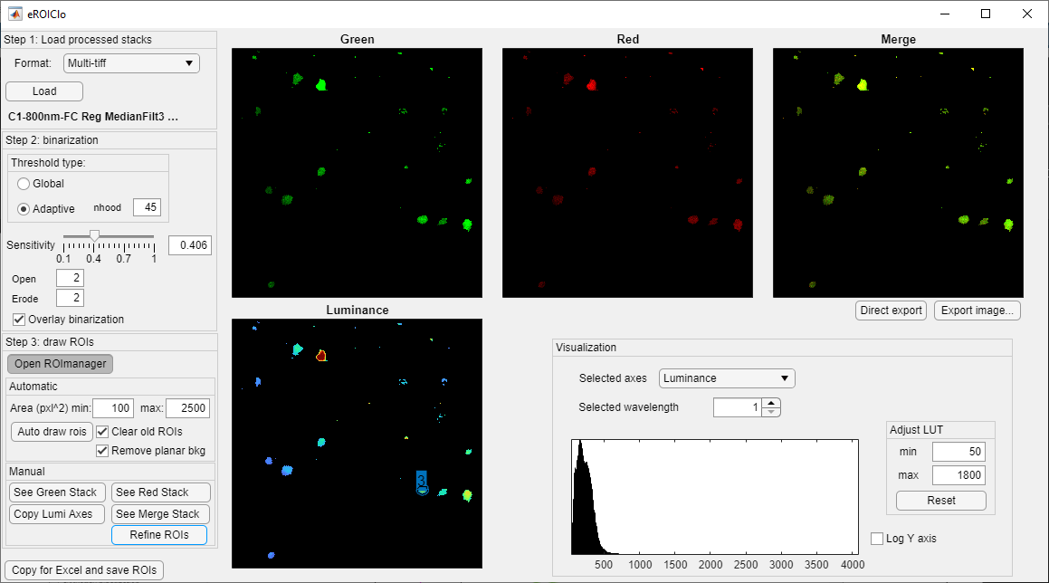
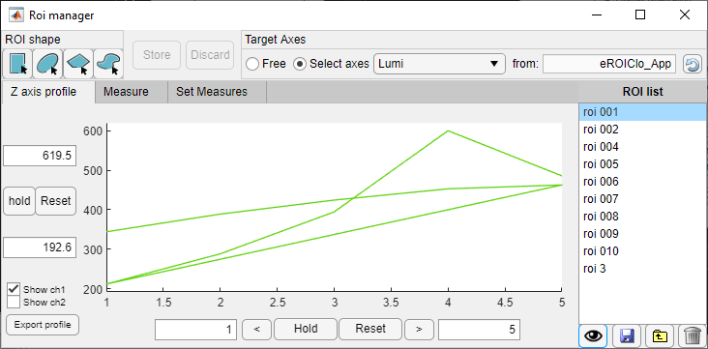
eROIClo
Your ROI is not precise? No worries:
Make sure the “Lumi” axes is selected in ROImanager and the mask is active in eROIClo.
Press “Refine ROIs”. TADAN! You have a precise ROI now.
You can draw and store many ROIs and then “refine” all of them at the same time: “Refine ROIs” works on all the ROIs on Lumi axes that haven’t been generated with “Auto draw rois”.

Slide 24
eROIClo
6) Save. This button will:
Compute the average on every ROI in both channels and copy it to the clipboard
Save the ROIs in a .mat file in the same folder as the source images.
ROIs can be loaded on ROImanager at any moment with this button .

Slide 25
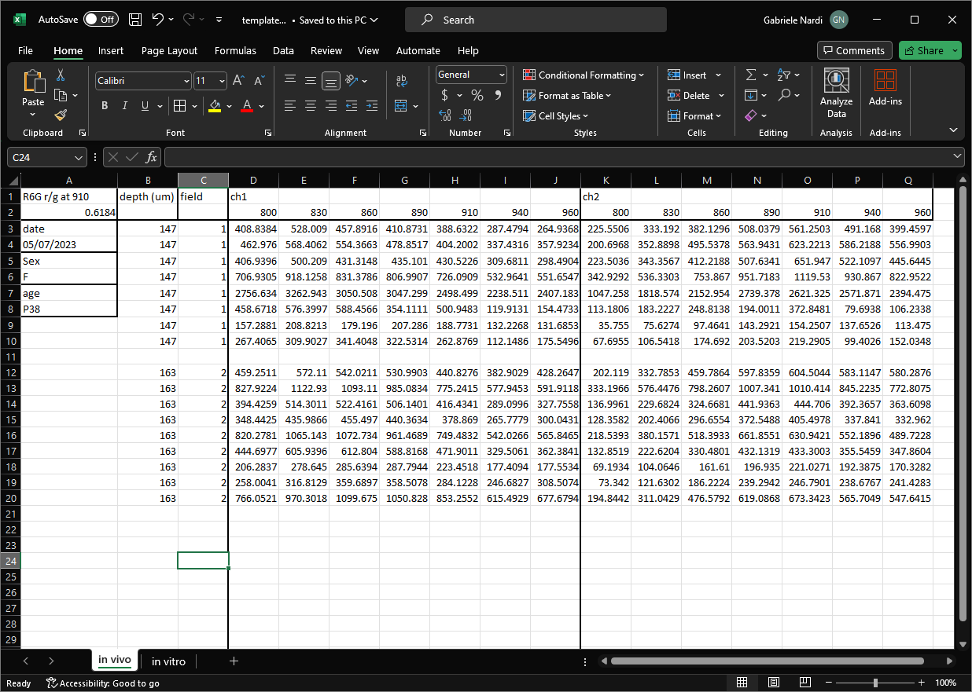
eROIClo
Paste the output into an
Excel file like this one. You can find this template in the main folder
R6G ratio (R/G) obtained with
FlatFieldAnalyzer
General info not accounted for
Depth in case of in vivo imaging
Paste HERE (D3).
Then edit line 2 (wavelengths) and write “ch1” and “ch2” in line 1, on the 1st column of each channel

Slide 26
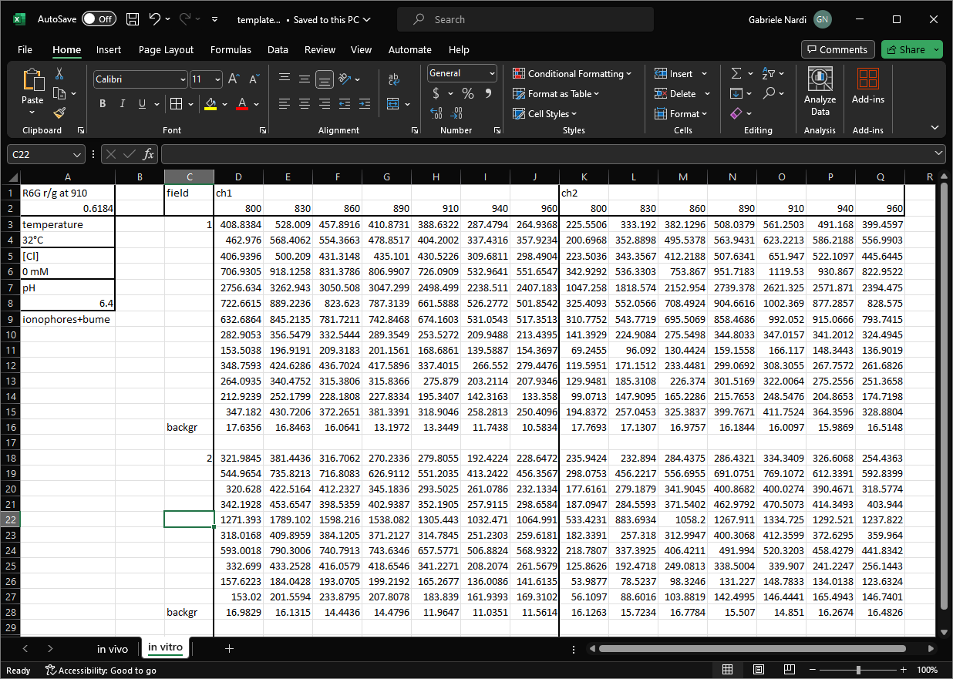
eROIClo
Paste the output into an
Excel file like this one. You can find this template in the main folder
If you want to subtract a background from a ROI, that one must be the last one for each field. Leave one or more empty rows between consecutive fields.

Slide 27
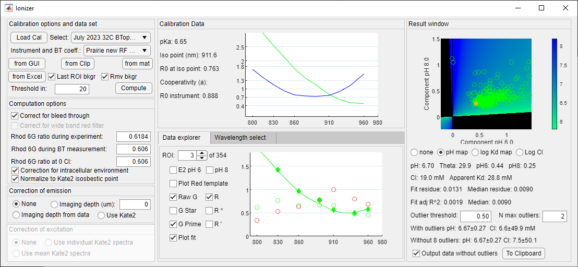
Inonizer2.0

Slide 28

Inonizer2.0
Ionizer is mostly unaltered in its GUI. Here the few changes:
Button for loading data from template Excel files (w or w/o background subtraction)*
We can have calibrations with relative spectra (green divided by red at each wavelength). This means correct intrinsically for excitation.
Possibility to select / deselect input wavelengths
Maps fixed.
2
1
3
4
2
*Once an Excel file has been selected, you’ll be asked to choose a spreadsheet in the command window.

Slide 29
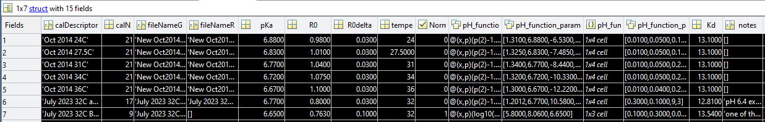
Inonizer2.0
Most of the changes happened “inside”
Calibration files:
“CalibrationSet.m” is now called “CalibrationSet_New.m” and it’s a structure array, where each element describes a calibration file. Here I highlight what’s new:
“Normalized” calibrations
have no “red” spectrum
Anonymous function* to convert epsilon/delta into pH.
pH function parameters, names and errors.
Boolean: normalized or not.
*Anonymous functions allow to store any pH calibration function with any number of parameters for different calibrations.

Slide 30
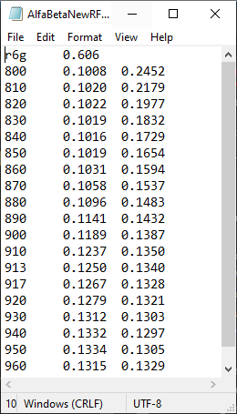
Inonizer2.0
Most of the changes happened “inside”
Calibration files:
“CalibrationSet.m” is now called “CalibrationSet_New.m” and it’s a structure array, where each element describes a calibration file.
Also “InstrumentsSet.m” is now a structure array.
Txt files with BT coefficients now have the R6G ratio as a header. It is automatically loaded and updated when switching between instruments. No more errors!

Slide 31
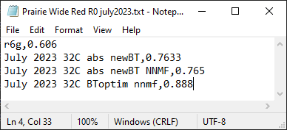
Inonizer2.0
Most of the changes happened “inside”
Calibration files:
“CalibrationSet.m” is now called “CalibrationSet_New.m” and it’s a structure array, where each element describes a calibration file.
Also “InstrumentsSet.m” is now a structure array.
Txt files with BT coefficients now have the R6G ratio as a header. It is automatically loaded and updated when switching between instruments. No more errors!
R0 files now have the R6G ratio as a header too. Also, each file is instrument-specific, but there might be several R0 measures for the same instrument corresponding to different calibration. Thus, R0 values are preceded with a string that exactly matches its calibration “Descriptor”.

Slide 32
Inonizer2.0
Most of the changes happened “inside”
Calibration files.
Import function. I created a function called “importFromStruct(app,data)“ that is meant to be a general way to load data on Ionizer2. Ideally, specific functions can load data from any source (system clipboard, Excel files, Matlab structures...) and store them in a scalar structure (the input argument “data”) that must have the following fields:
g: 2D matrix with dimensions roi*wavelength, with green fluorescence values.
r: 2D matrix with dimensions roi*wavelength, with red fluorescence values.
wl: row array with excitation wavelengths in nm.
z: (optional) column array with the imaging depth (in microns) for each ROI.
r6g: (optional) Rhodamine 6G value (red over green at 910 nm, using Rhodamine6G 10uM). NOTE: if no r6g value is given in this way, it MUST be entered manually by the user in the proper EditField.
Thus, a proper data loading pipeline should be:
Import data with a specific function.
Arrange data as in the structure described above.
Call the function "importFromStruct“.

Slide 33
Inonizer2.0
Most of the changes happened “inside”
Calibration files.
Import function.
Got read of most of for loops
Compute pH and compute Cl are now external functions because they are useful also outside the app (e.g., for calibration scripts)

Slide 34
Inonizer2.0
Most of the changes happened “inside”
Calibration files.
Import function.
Got read of most of for loops
‘compute_pH’ and ‘compute_Cl’ are now external functions because they are useful also outside the app (e.g. for calibration scripts)
‘compute_pH’ uses a function for pH that is specific of each calibration:
The function syntax is the following:
[pH,delta,epsilon,theta,res,R2_adj] = compute_pH(g,G1,G2,fit_fcn,fit_param)
g are the measured green fluorescence (rows are ROIs, columns are wavelengths), G1 and G2 are the spectra from calibrations (e.g. pH6 and pH8), fit_fcn is an anonymous function stored in the calibration structure for each calibration. Example: for the calibration 'Oct 2014 24C’, it is the “old” function:
fit_fcn = @(x,p) (p(2)-1./p(1)*log10((p(4)-atand(x))./(atand(x)-p(3)))) where x should be epsilon/delta, and
fit_param = [1.31, 6.88, -6.53, 93.34]; parameters are: a, pka, thetaL and thetaR.
For a new calibration, instead,
fit_fcn = @(x,p)(log10((x.*10.^(p(1)+p(2))+x.*10.^(p(2)+p(3))+10.^(p(1)+p(2))+10.^(p(1)+p(3)))./(10.^p(2)+10.^p(3)+x.*10.^p(3)+x.*10.^p(1)))) , and
fit_param = [5.8, 8.06, 6.65]; parameters are: pH1, pH2, pKa

Slide 35
Inonizer2.0
How to include new sensors (e.g., the Clover+CrispRed one)?
I think it should be enough to add the field “Sensor” to the calibration structure, and to show the name of the sensor
in a graphic element of the map.

